Slide 1
Review for midterm
Management Information Systems
Disha Parkhi

Slide 2
One-to-many relationship
A
1 M
B
Each record of table A corresponds to 0, 1, 2,….(many) records of table B
Each record of table B corresponds to 0 or 1 record of table A
To create this relationship we put the primary key of A as a foreign key in table B (the foreign key is always in “the many” table).
The foreign key may be left empty (null), in which case it means that the record of B corresponds to 0 records of A.

Slide 3
Subtypes
A
1 0 /1
B
Each record of table A corresponds to 0 or 1 record of table B
Each record of table B corresponds to 1 record of table A
To create this relationship we put the primary key of A as a foreign key in table B and also as its primary key (this ensures that to each record of B corresponds a single record of A).

Slide 4
many-to-many relationship
M M
A
W
B
Each record of table A corresponds to 0, 1, 2, … records of table B
Each record of table B corresponds to 0, 1, 2, … records of table A
To create this relationship we create a new table W. The primary key of table A and of table B are foreign keys in table W.

Slide 5
Anomalies
Anomalies are problems caused by poor database design.
An update anomaly occurs when one must make many changes to reflect the modification of a single piece of information.
A deletion anomaly occurs when data is deleted from a relation, and other critical data is unintentionally lost
An insertion anomaly occurs when a row cannot be added to a table, because not all data is available (or one has to invent “dummy” data)

Slide 6
Normal forms
Normal forms are rules that help prevent anomalies.
1NF: all tables’ attributes are atomic: no nested tables or subtables; no attribute should be a list of values; no repeating groups of attributes
  2NF: 1NF + any non-key field cannot depend on part of the primary key
3NF: 2NF + No non-key attribute is dependent on any other non-key attribute or composition of any non-key attributes, EXCEPT if the latter attribute(s) could have been used as an alternative key of the table.

Slide 7
Review on normal forms and DB anomalies

Slide 8
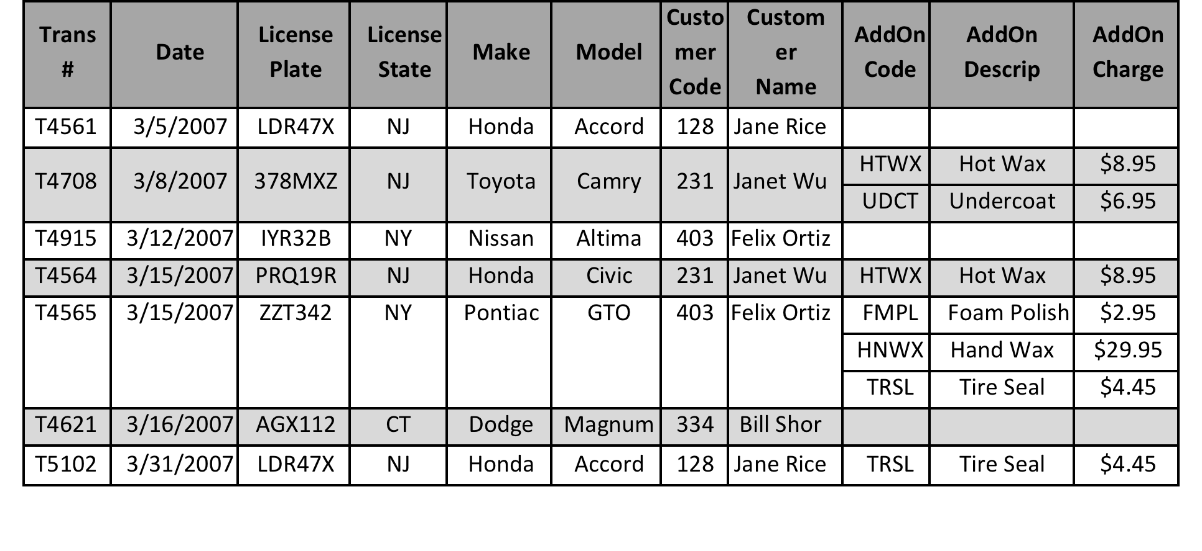
Consider a car wash company that keeps records using a table similar to the following simplified table whose PK is “Trans #”:
Each record corresponds to a single car wash (transaction), and contains the following information: date of the transaction, license plate, license state, make and model of the car, customer code and customer name. The fields AddOnCode, AddOnDescrip, and AddOnCharge are allowed many rows for each transaction, each indicating which optional services were added to the basic wash operation.
You may assume that the car wash always charges the same amount for each optional service.

Slide 9
Questions
1. Give examples of insertion, deletion and update anomalies.
2. Is the table in 1NF? 2NF? 3NF? Why?
3. Fix the table so that it is in 3NF.

